Slide 1

Unlocking Data Driven Decisions
By Team-1
Ankit Raj, Tarinee, Prashant, Vaishnavi Gattagoni
,Uswa Shariq, Mustafa Oun, Varun Jose Madanu and Anchal Kedia

Slide 2
Objectives & Problem Statement :
Objective:
Build centralized, interactive dashboards from multiple data sources
Simplify complex data through visual storytelling
Identify trends, patterns, and anomalies for proactive decisions
Monitor KPIs in real time
Problem Statement:
Delays due to siloed, inconsistent data
Manual consolidation led to errors and confusion
Limited collaboration from outdated reports
Need for intuitive visuals for faster decision-making

Slide 3
Data Collection & Processing:
Data Source (Master Table):
Marketing Dataset:
Processing Steps:
Processed independently.
Cognito Data
Cohort Data
Learner Opportunity Data
Opportunity Data
User Data
Joined via primary & foreign keys for a unified master table
Data extraction from PostgreSQL
Cleaning & filtering
Integration & joining
Transformation
Validation
Visualization in Looker Studio

Slide 4
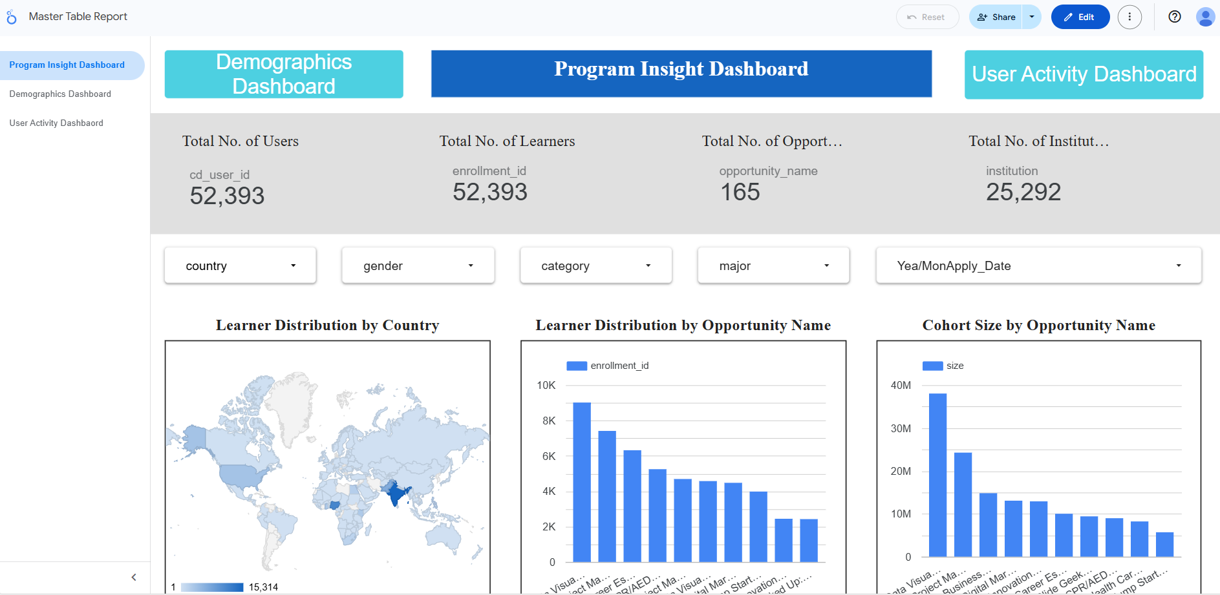
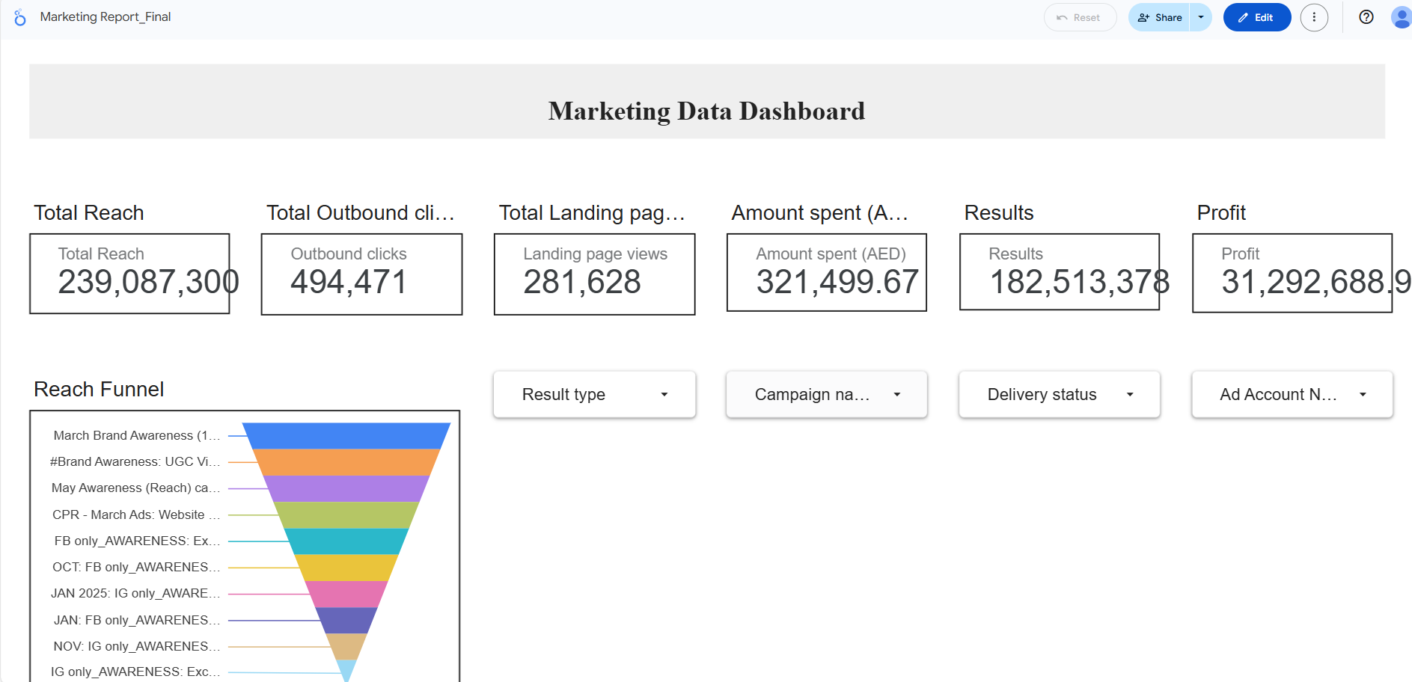
Dashboard Overview:
For Visiting Master Table Dashboard:
Click: Master Table Report › Program Insight Dashboard
For Visiting Marketing Table Dashboard:
Click:Marketing Report_Final

Slide 5
Master Table: Key Metrics Summary
148
India
Computer Science
Total No. of Countries
Most Represented Country
Most Common Major
52,393
165
25,292
Total No. of Learners
Total No. of Opportunities
Total No. of Institutions

Slide 6
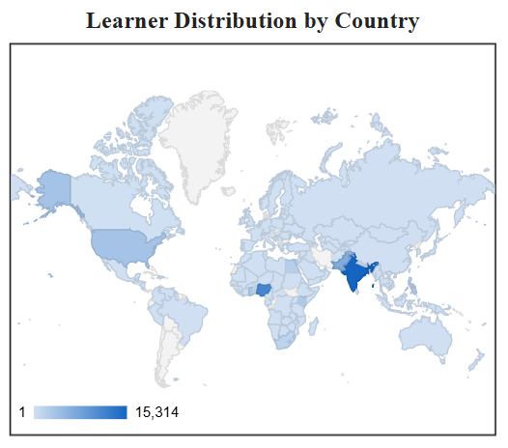
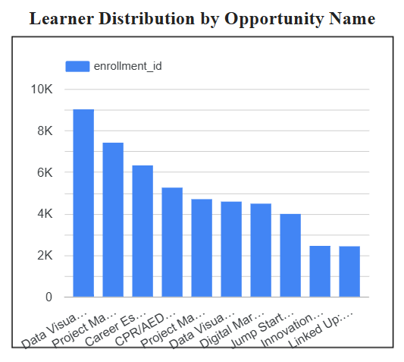
Insights from Master Table:
Insight 1: Learner Distribution by Country
Majority of learners are from key countries — tailor content to top regions.
Insight 2: Learner Distribution by Opportunity Name
Some opportunities draw more learners — scale popular ones, review low performers.

Slide 7
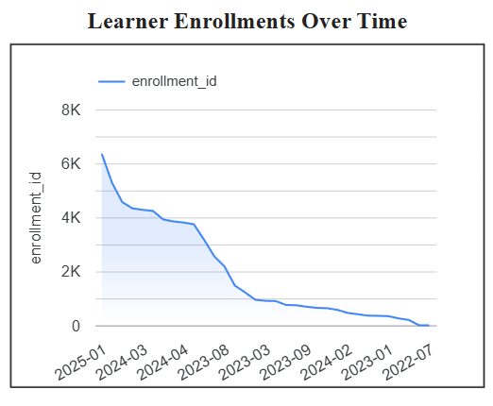
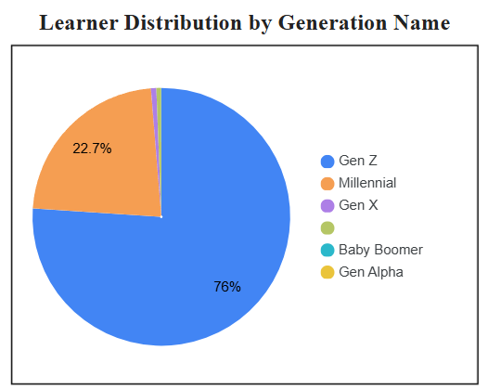
Insight 3: Learner Enrollment Over Time
Learner sign-ups show spikes — align campaigns with peak periods.
Insight 4: Learner Distribution by Generation Name
Majority are Gen Z and Millennials — target them via popular social media platforms.

Slide 8
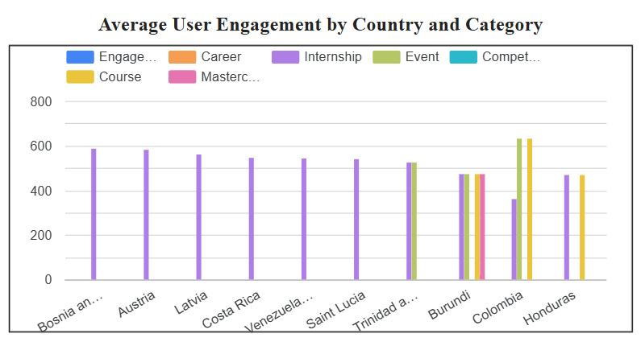
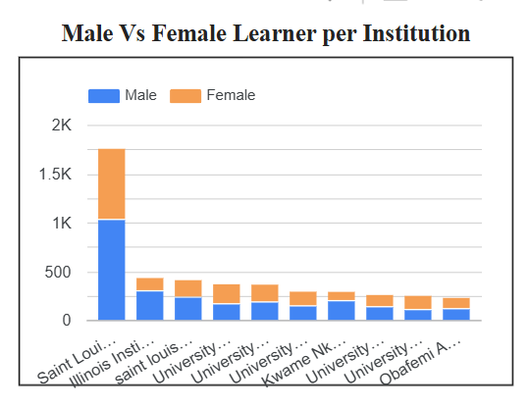
Insight 5: Average Engagement by Country and Category
Higher engagement in certain countries/categories — focus investment there.
Insight 6: Male vs Female Learners by Institution
Gender participation varies by institution — tailor outreach to improve balance.

Slide 9
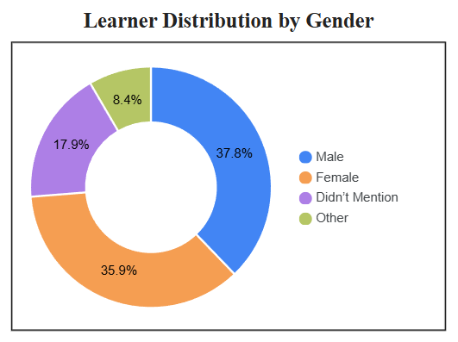
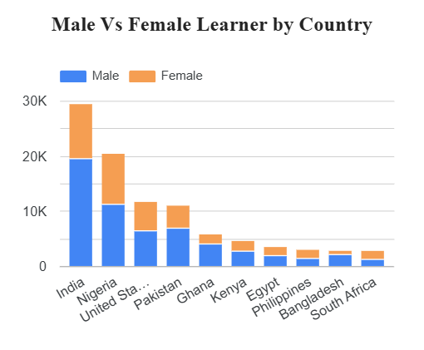
Insight 7: Learners Distribution by Gender
Gender participation varies— tailor outreach to improve balance.
Insight 8: Male vs Female Learners by Country
Gender participation varies by region — tailor outreach to improve balance.

Slide 10
Marketing Table: Key Metrics Summary
239,087,300
494,471
281,628
Total Reach
Outbound Clicks
Total Landing pages
321,499.67
182,513,378
31,292,688.9
Amount Spent (AED)
Results
Profit

Slide 11
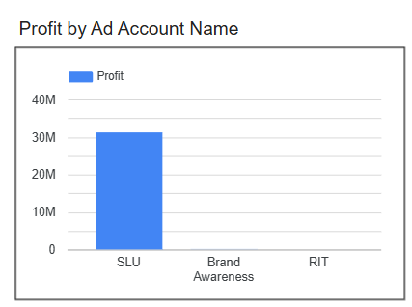
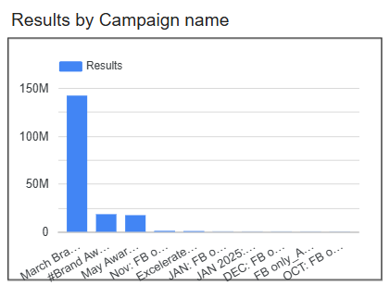
Insights from Marketing Table:
Insight 1: Profit by Ad Account
Some ad accounts perform better — focus budget on high-return ones.
Insight 2: Campaign Performance by Name
Some campaigns perform better — scale top ones, refine or pause low performers.

Slide 12
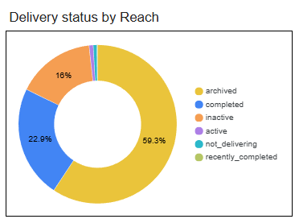
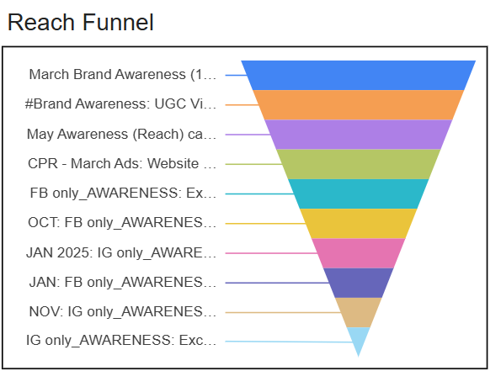
Insight 3: Delivery Status by Reach
Reach varies by ad status — pause or remove underperforming ads.
Insight 4: Reach Funnel
The image shows an inverted Reach Funnel chart comparing the effectiveness of various brand awareness campaigns by reach.

Slide 13
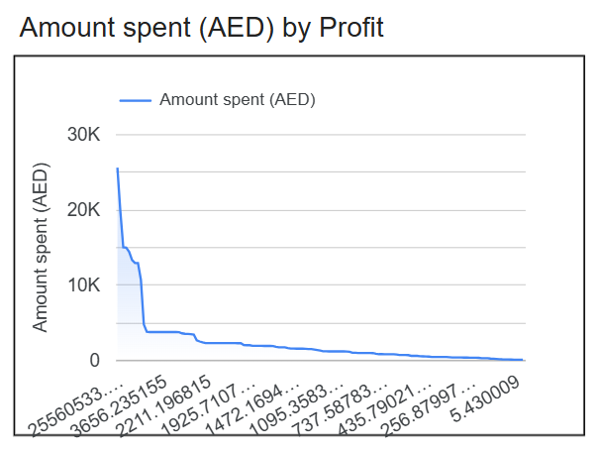
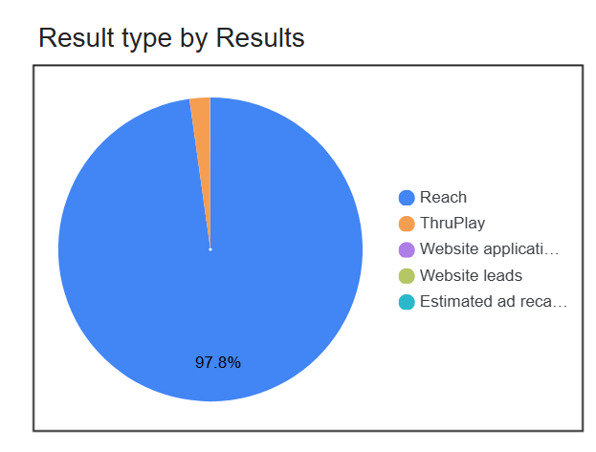
Insight 5: The chart shows how the amount spent (AED) decreases as profit values increase, indicating a skewed distribution with high spending concentrated at lower profit levels.
Insight 6: The pie chart shows that 97.8% of the results are attributed to Reach, dominating over other result types like ThruPlay and Website leads.

Slide 14
Recommendation:
Invest more in high-ROI campaigns — shift budget to top-performing channels.
Track cohort retention trends — act early on signs of drop-off.
Target low-performing segments — personalize content and communication.
Automate data refresh — enable real-time, reliable dashboard monitoring.

Slide 15
Team Contribution
Ankit Raj (Team Lead)- Documentation and Dashboard Building
Tarinee (Project Manager)- Dashboard Building and Ppt Formatting
Prashant Kashyap (Project Lead)- Documentation and Data Preprocessing
Varun Jose Madanu (Project Scribe)- Meeting insights and Data Preprocessing
Mustafa Oun (Team Member)- Documentation
Vaishnavi Gattagoni (Team Member)- Documentation and Ppt Formatting
Uswa Shariq (Team Member)- Documentation
Anchal Kedia (Team Member)- Documentation and Feedback

Slide 16


